Slide 1


Major Project-I (7th Semester)
AI Based Downscaling of Satellite Air Quality Maps using Deep Learning
Presented by:
SK Akilur Rehman(23CSE585)
Priyanka Chhatar (23CSE564)
Sandhyarani Sahu(23CSE558)
Supervised by: Mr. Tirupati Sahu
1

Slide 2
CONTENT
1.Introduction
2.Abstract
3.Problem Statement
4.Technology Used
5.ER Diagram
6.Flowchart
7.Challenges
8.Future Aspects
2

Slide 3
INTRODUCTION
The Air pollution monitoring is essential for understanding and controlling pollution in urban and regional areas. Sentinel-5P satellite data provides large-scale air quality information, but its coarse spatial resolution makes it difficult to identify hyper-local pollution hotspots. This project uses AI-based downscaling and super-resolution techniques to generate more detailed air quality maps by integrating satellite, ground monitoring, and meteorological data..
3

Slide 4
ABSTRACT
This project proposes an AI-based system to enhance the spatial resolution of Sentinel-5P air quality data. Satellite pollutants such as NO₂, SO₂, CO, O₃, and Aerosol Index are combined with CPCB monitoring data and ERA5 meteorological data. CNN-based Super Resolution, Vision Transformer, and Random Forest models are compared to identify an effective downscaling approach. The resulting high-resolution maps are provided through a FastAPI-based system and GIS-enabled web platform for air quality analysis and decision-making.
4

Slide 5
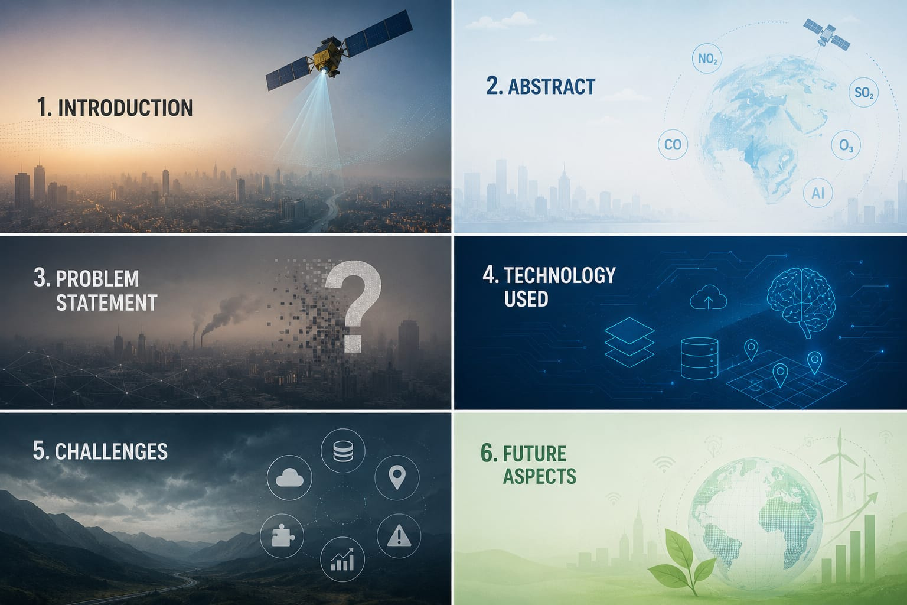
Problem Statement
The core gaps
  Satellite air quality data i.e. Sentinel 5P which is spatially coarse often several kilometers per pixel.
  This makes it impossible to pinpoint hyper local pollution hotspots needed for street or neighborhood level action.
  Ground stations are accurate but too sparse for continuous spatial coverage.
Need Addressed
  Fine grained, high resolution pollution maps for urban & regional analysis
  Reliable input for government agencies & researchers to make informed decisions
  A scalable method to fuse satellite, ground station, and weather data
5

Slide 6
TECHNOLOGIES USED
  Sentinel-5P – Satellite air quality data
  ERA5 – Meteorological/weather data
  CPCB – Ground-based air quality monitoring data
  CNN Super Resolution – Spatial downscaling
  Vision Transformer (ViT) – Deep learning-based downscaling
  Random Forest – Machine learning comparison model
  FastAPI – REST API backend
  React / Next.js – Web interface
  PostgreSQL + PostGIS – Spatial database & GIS
  Regression Metrics – Model evaluation and validation
6

Slide 7
ER DIAGRAM
7

Slide 8
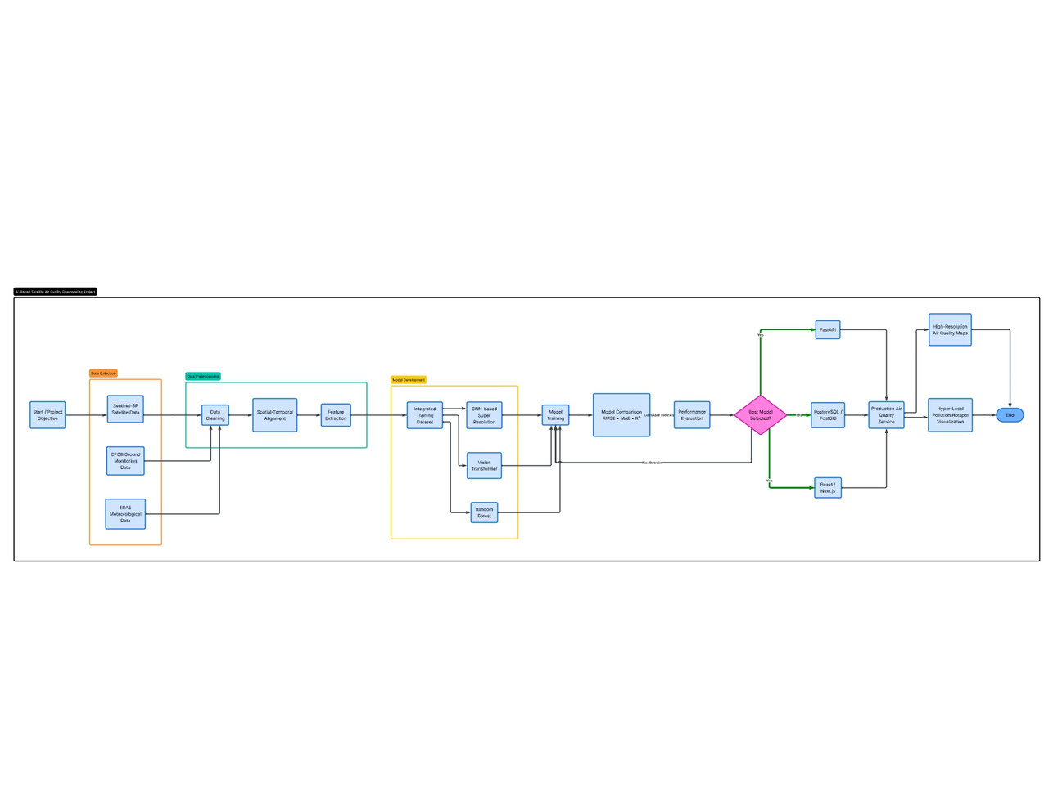
Flowchart:
8

Slide 9

CHALLENGES
  Fusing heterogeneous data (satellite, ground station, weather) with different resolutions and formats
  Coarse-to-fine resolution mismatch makes ground-truth validation difficult
  Selecting the best-performing model among CNN, ViT, and Random Forest
  Ensuring accuracy and reliability of downscaled maps against real monitoring data
9

Slide 10
FUTURE ASPECTS
  Real-time pollution alert system for high-risk zones
  Extend model to more pollutants and finer time resolution
  Deploy on cloud (AWS/GCP) for scalable, nationwide coverage.
  Mobile app for citizens & policymakers with live AQI maps
10

Slide 11
THANK
YOU
11

